Slide 1
Chapter 13. Time series models
Financial Econometrics
Department of financial engineering
Zhongnan university of economics and law
Xu Yonghao

Slide 2
oUTLINE
ARMA
Classwork
VAR

Slide 3
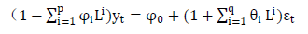
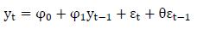
1.1 ARMA - intro
ARMA(p,q) is mixed of AR(p) and MA(q),
for example ARMA(1,1)
Essentially, it is AR(p)-type mean with a MA-type autocorrelated errors
AR(p) is useful in finance, but MA is not widely used
But AR(p) often have auto-correlated errors
We explicitly model the error using MA(q), this is why we need a ARMA model

Slide 4
1.1 ARMA - intro
Properties of ARMA(p,q)
Stationarity: the same as AR(p)
Mean: the same as AR(p)
Variance: 用下面的类推法
Autocorrelation:
for k>q, the same as AR(p), i.e., Yule-Walker equation holds
For k<=q, it is different

Slide 5
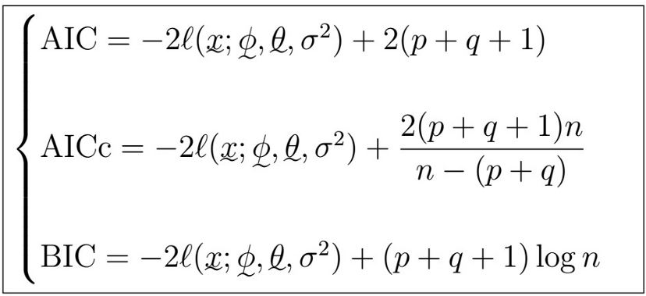
1.1 ARMA - intro

Slide 6
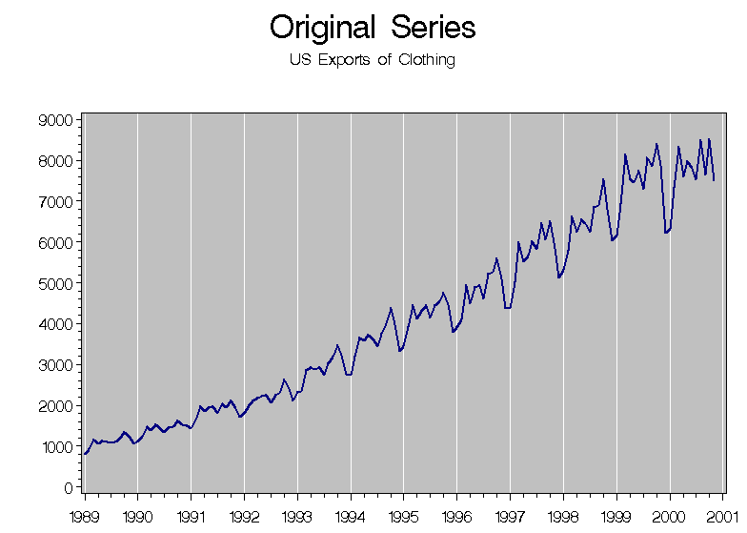
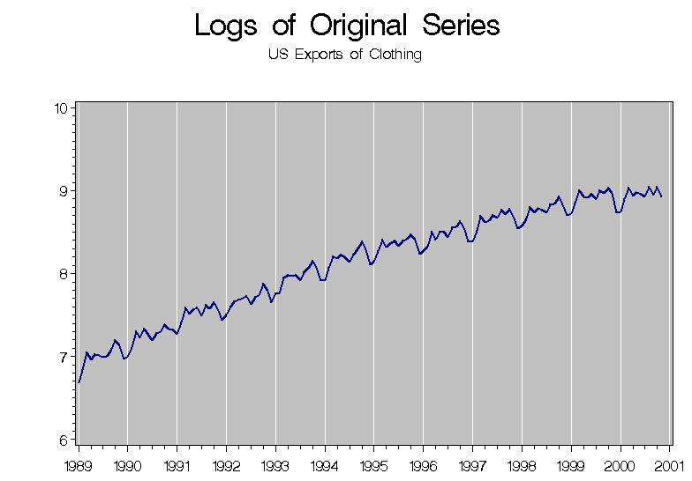
1.1 ARMA - intro

Slide 7
1.1 ARMA - intro
For example, the export data
它看来是一个取log后的确定性趋势过程
与带漂移项的随机游走相似，取log后的确定性趋势过程，在取log前也是方差越来越大。
但差别是，去掉时变的均值后，带漂移项的随机游走的方差还随时间增加而增加，而取log后的确定性趋势过程的方差平稳（它是随均值增加，不是随时间增加，尽管经常均值也随时间增加，比如上面export例子）
也就是说，拿到一个有明显趋势的数据，
首先看它是否应该取log（看均值与波动的关系，而不是时间与波动的关系）
再看是确定性趋势还是带漂移的随机趋势（看去均值后的波动与时间的关系）

Slide 8
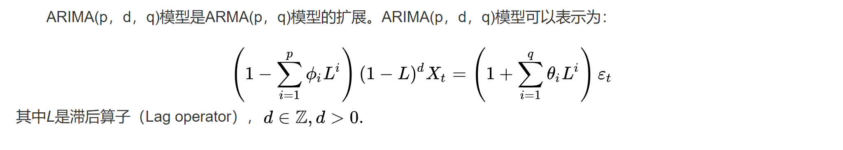
1.2 ARIMA - intro
An autoregressive integrated moving average (ARIMA) model is a generalization of an autoregressive moving average (ARMA) model.
ARIMA models are applied in some cases where data show evidence of non-stationarity in the sense of mean (but not variance/autocovariance), where an initial differencing step (corresponding to the "integrated" part of the model) can be applied one or more times to eliminate the non-stationarity of the mean function (i.e., the trend).

Slide 9
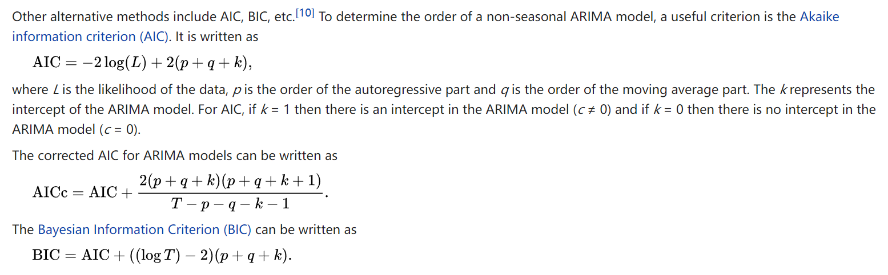
1.2 ARIMA - intro

Slide 10
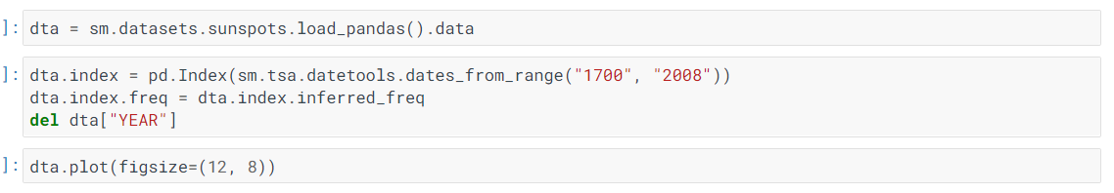
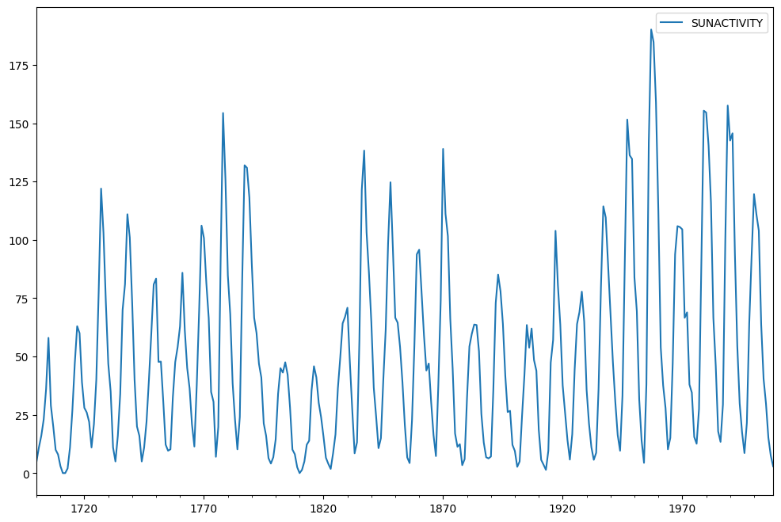
1.3 ARMA - Case
Source: https://www.statsmodels.org/dev/examples/notebooks/generated/tsa_arma_0.html

Slide 11
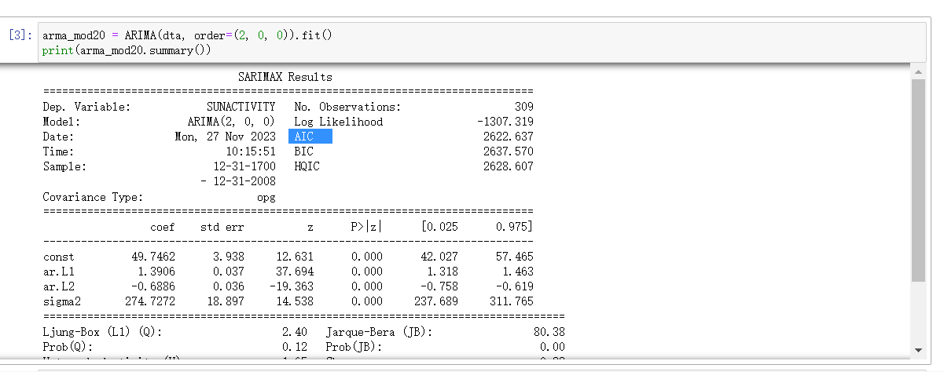
1.3 ARMA - est

Slide 12
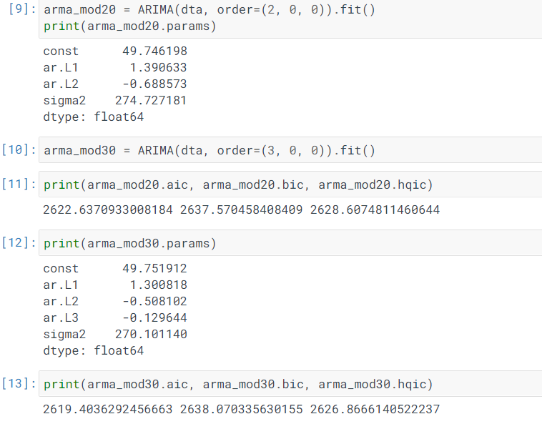
1.3 ARMA - est

Slide 13
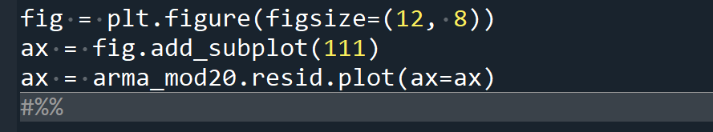
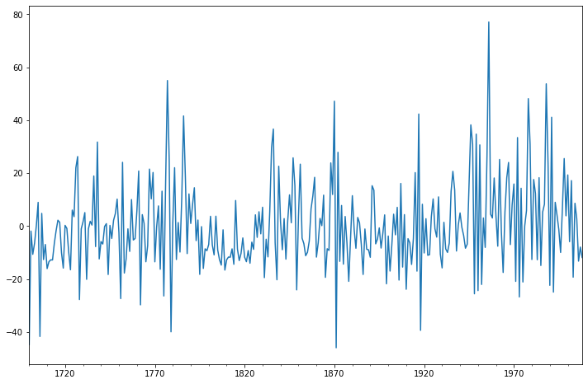
1.3 ARMA - residue

Slide 14
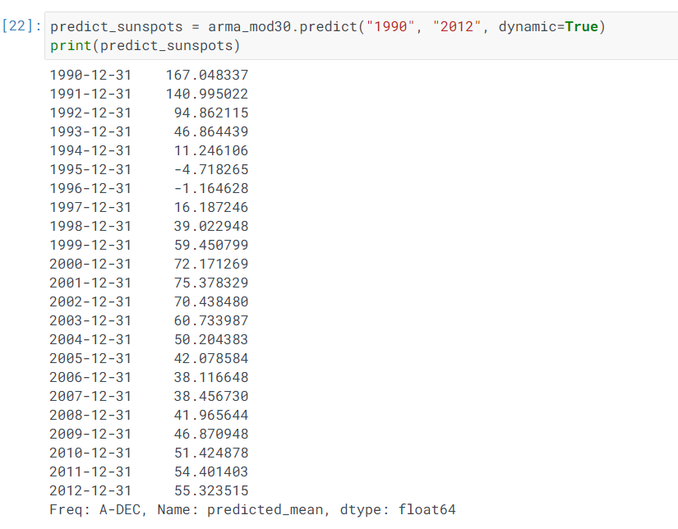
1.3 ARMA - prediction

Slide 15
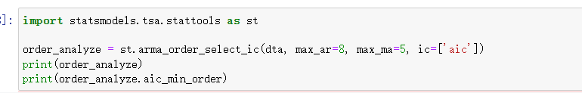
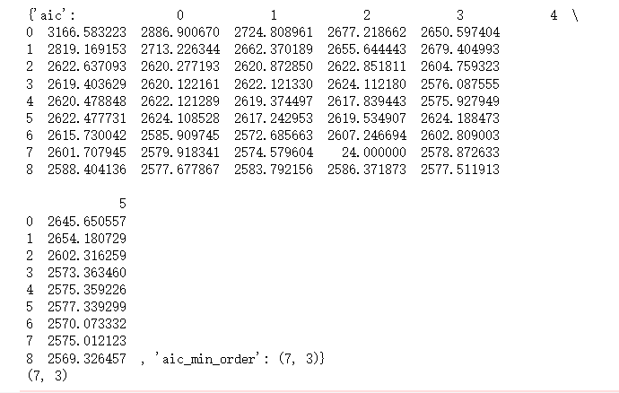
1.3 ARMA – choose pq

Slide 16
1.4 ARMA – summary
Step 1. visual inspecting the stationary condition
先取对数？粗略看下平稳性
Step 2 : 平稳性检验及平稳化
取对数差分 ； 直接差分 ； 多次差分等
进行ADF检验
Step 3 : 通过ACF粗略决定p和q的范围

Slide 17
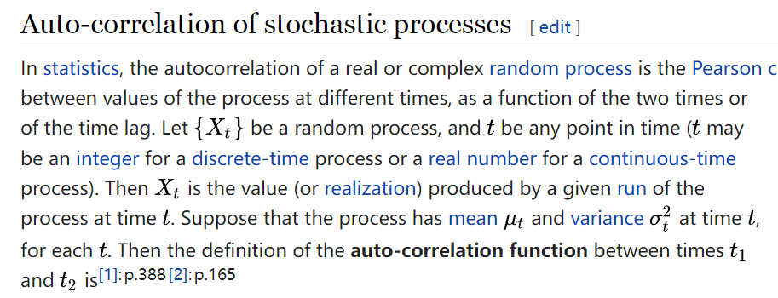
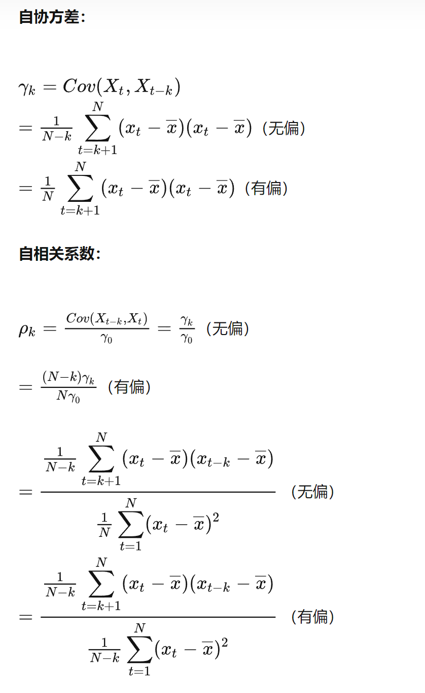
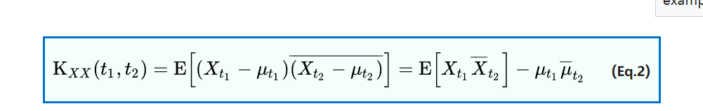
1.4 ARMA – summary – ACF

Slide 18
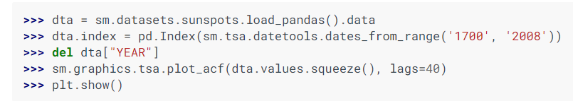
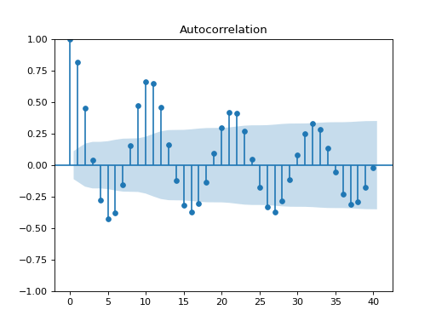
1.4 ARMA – summary – ACF

Slide 19
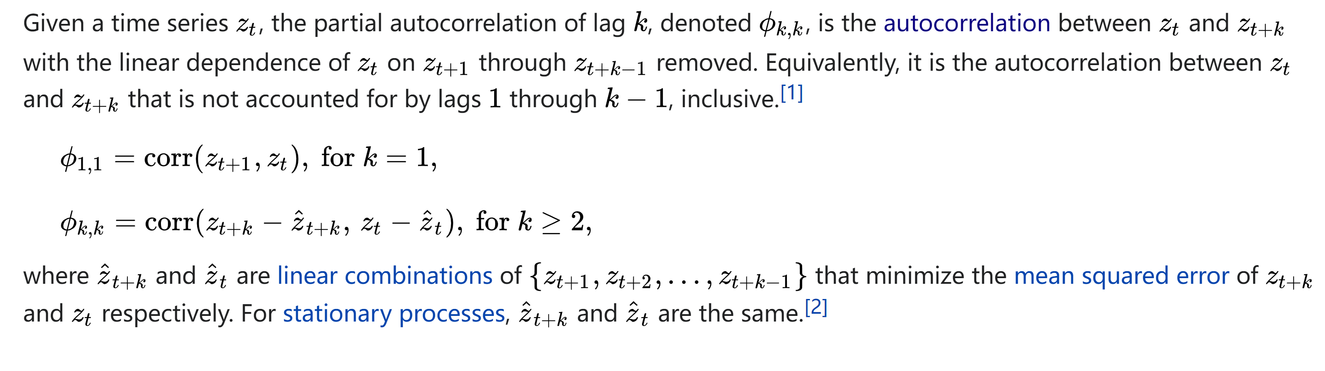
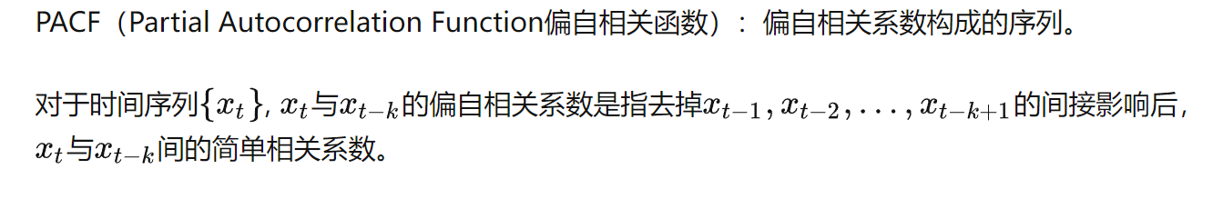
1.4 ARMA – summary – PACF

Slide 20
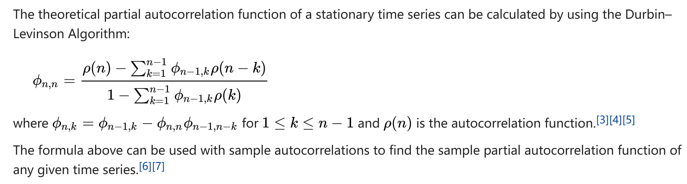
1.4 ARMA – summary – PACF

Slide 21
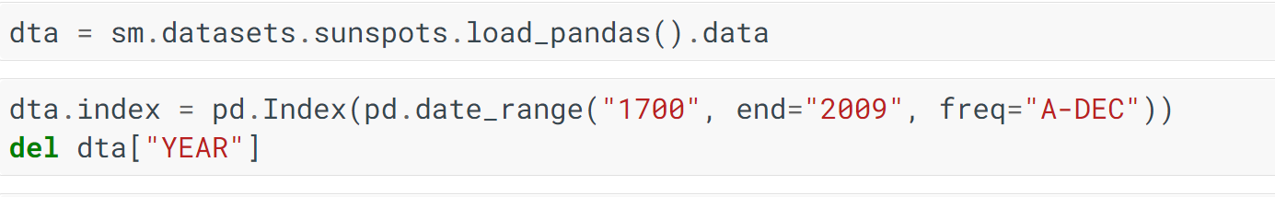
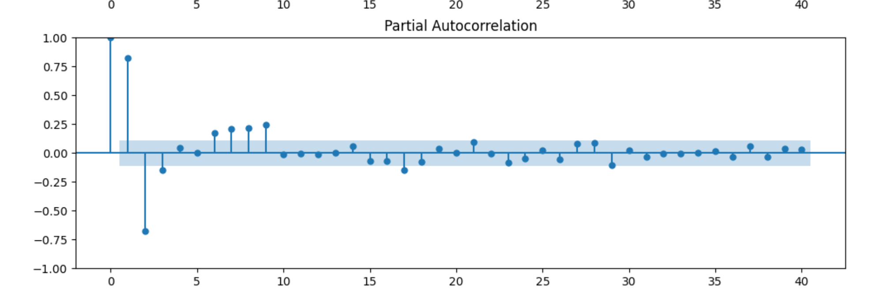
1.4 ARMA – summary – PACF

Slide 22
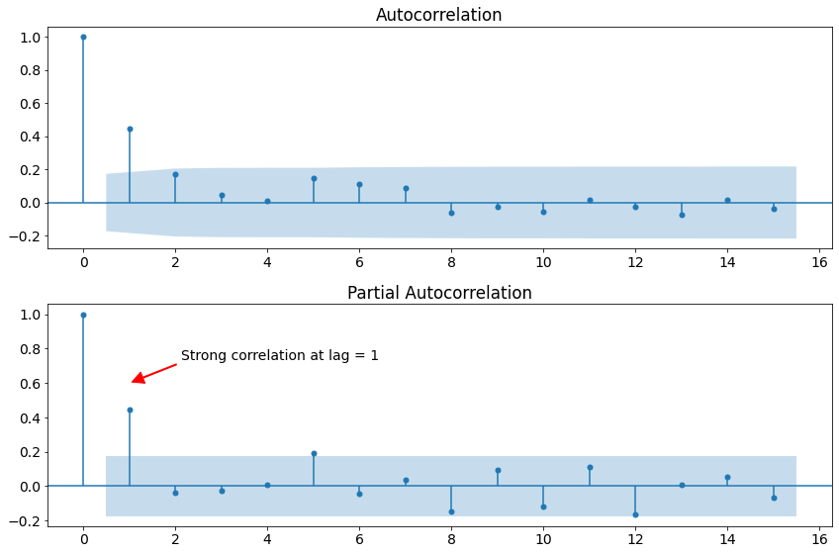
1.4 ARMA – acf and pacf
拖尾（tails off）：始终有非零取值，不会在k大于某个常数后就恒等于零(或在0附近随机波动)。
截尾(Cut off)：在大于某个常数k后快速趋于0为k阶截尾

Slide 23
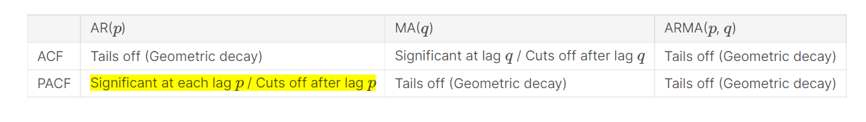
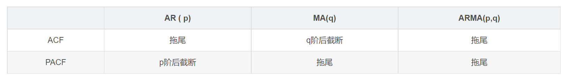
1.4 ARMA – acf and pacf
然后当确定是什么模型后，再看上面的阶数和2倍标准差范围，就能找到对应p、q值。

Slide 24
1.4 ARMA – acf and pacf
ACF截尾
PACF在p处显著；
根据PACF选取AR（P）
大致就是AR1 or AR2

Slide 25
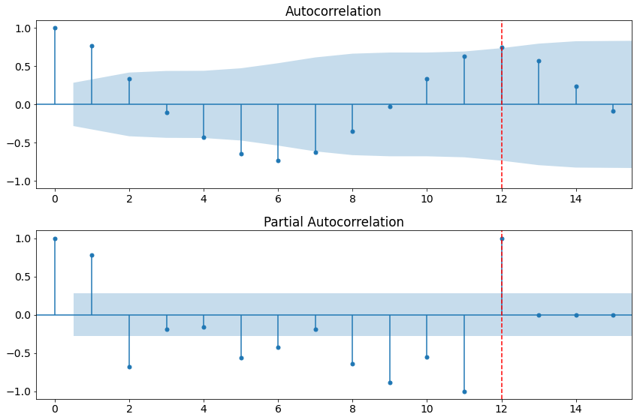
1.4 ARMA – acf and pacf
ACF截尾
PACF拖尾
根据pacf选取AR（P）
大致就是AR12

Slide 26
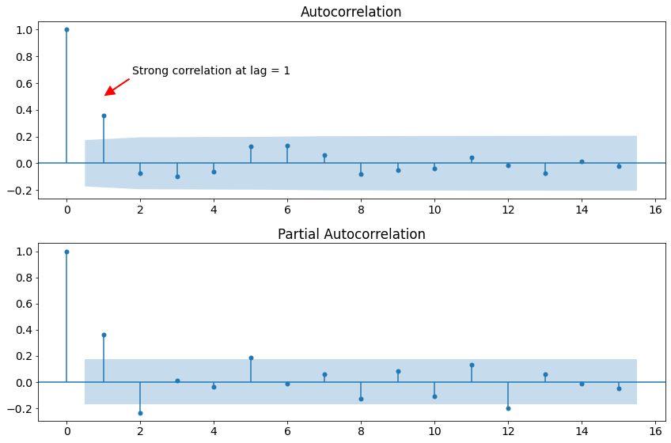
1.4 ARMA – acf and pacf
ACF在q显著；截尾
PACF截尾
根据ACF选取MA（Q）
大致就是MA1 or MA2

Slide 27
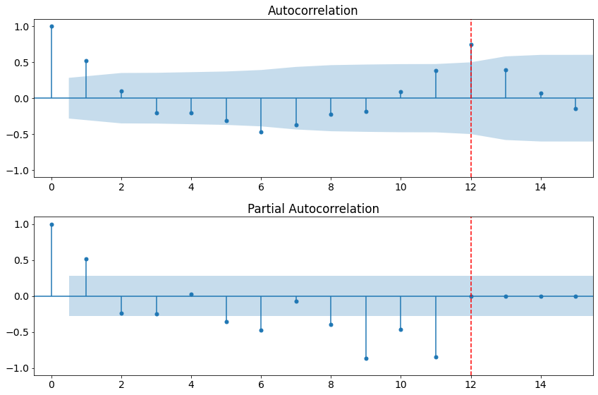
1.4 ARMA – acf and pacf
ACF拖尾
PACF拖尾
ARMA（P）
大致就是ARMA(12,12)

Slide 28
1.4 ARMA – summary
Step 4. 根据AIC与BIC确定p与q
同时，根据简约原则，选取尽量简洁的模型（即p与q小）
Step 5: 进一步根据样本内与样本外预测误差，微调模型的p与q

Slide 29
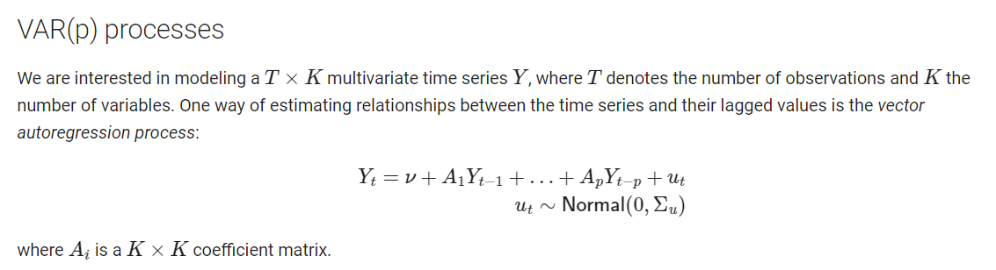
2 VAR
向量自回归模型（vector autoregressive model，简称VAR模型）是非结构性方程组模型，由Sims于1980年提出。在模型的每一个方程中，内生变量对模型的全部内生自变量的滞后项进行回归，进而估计全部内生变量的动态关系，常用于预测相互联系的时间序列系统以及分析随机扰动对变量系统的动态冲击。

Slide 30
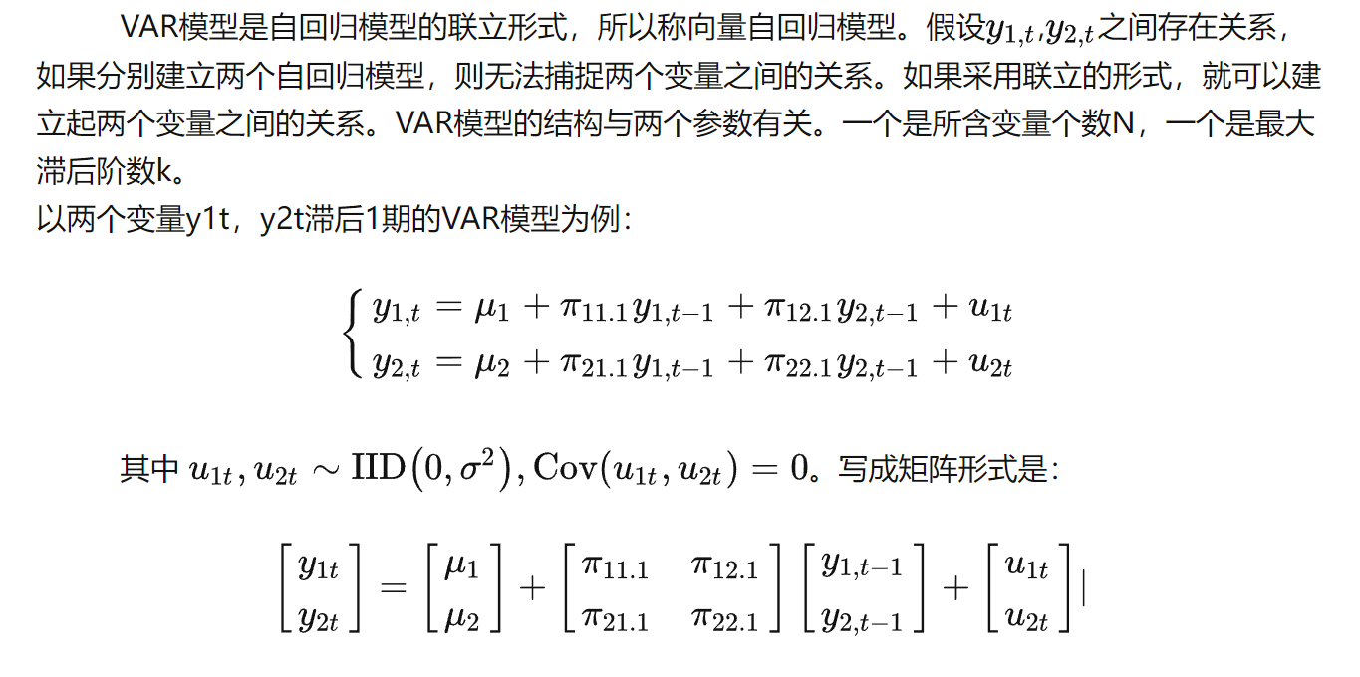
2.1 VAR - introduction

Slide 31
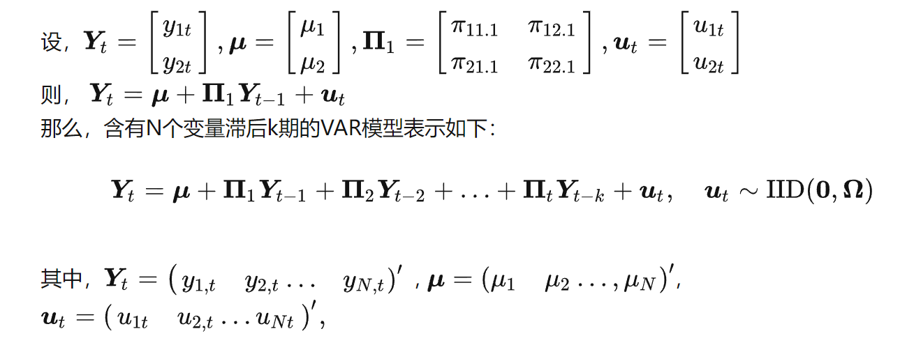
2.1 VAR - introduction

Slide 32
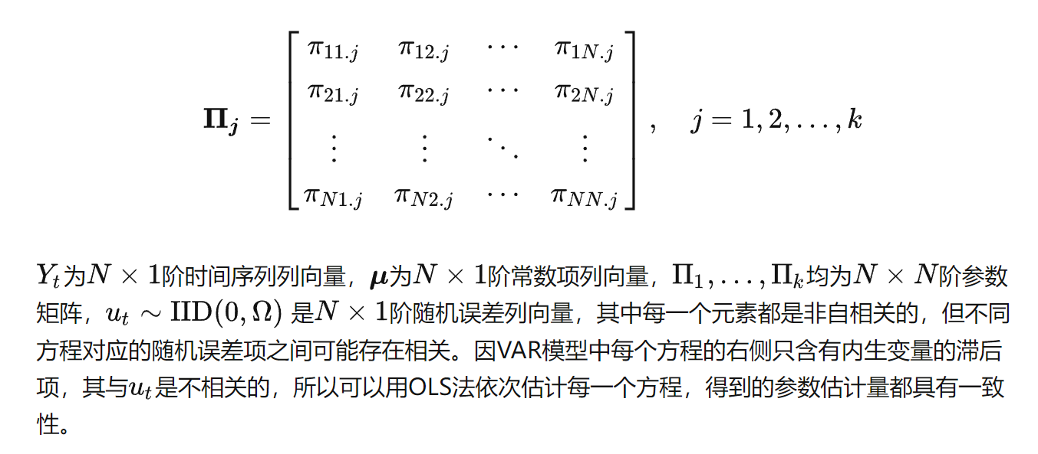
2.1 VAR - introduction

Slide 33
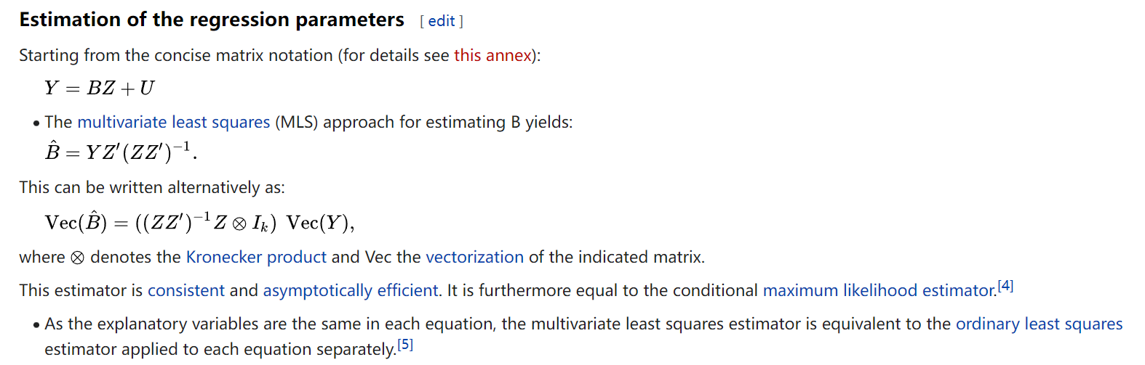
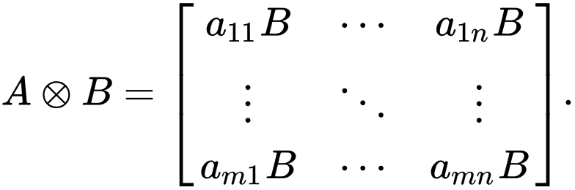
2.2 VAR – estimation - coefficient
克罗内克积

Slide 34
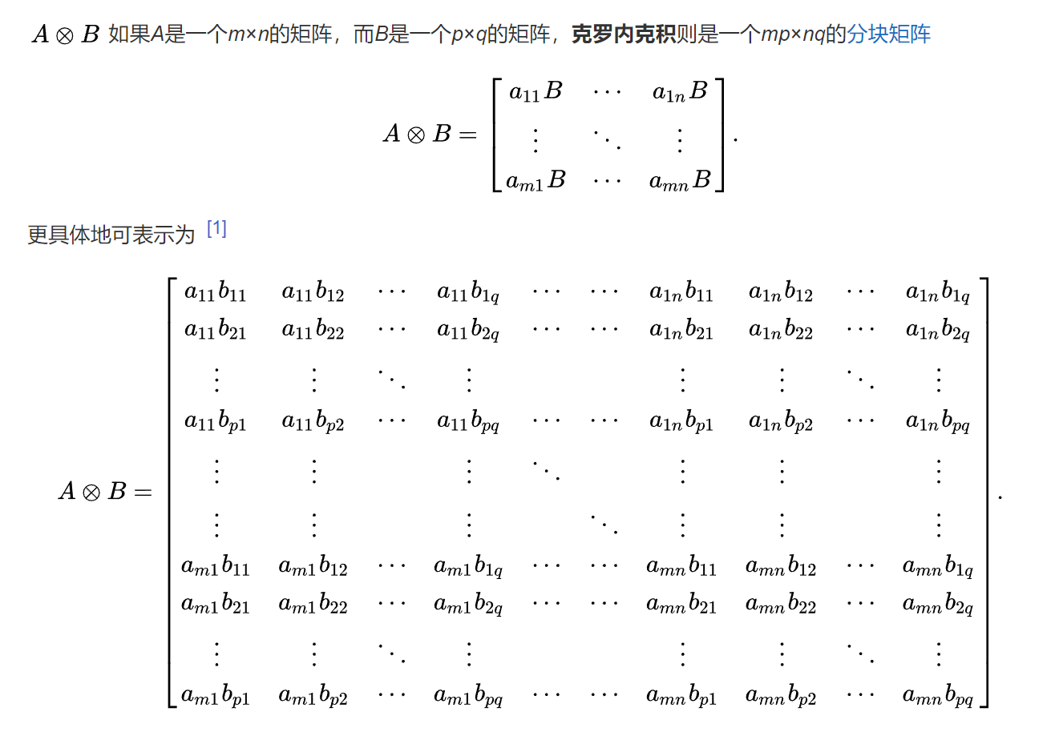
2.2 VAR - estimation

Slide 35
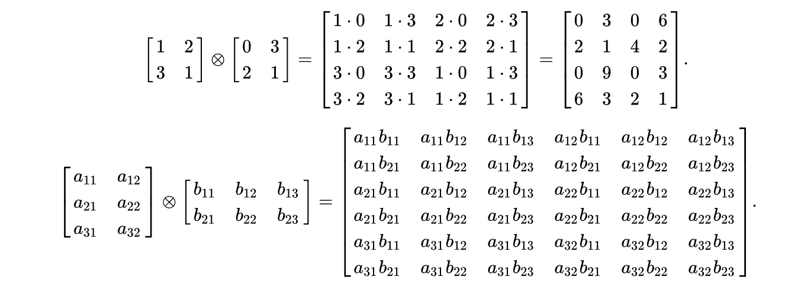
2.2 VAR - estimation

Slide 36
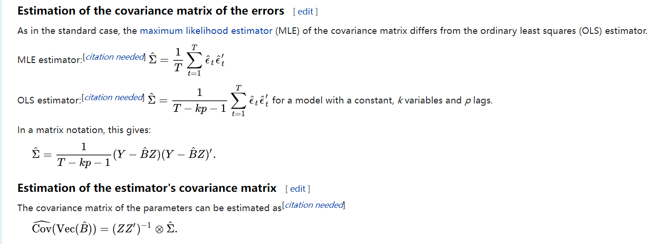
2.2 VAR – estimation - variance

Slide 37
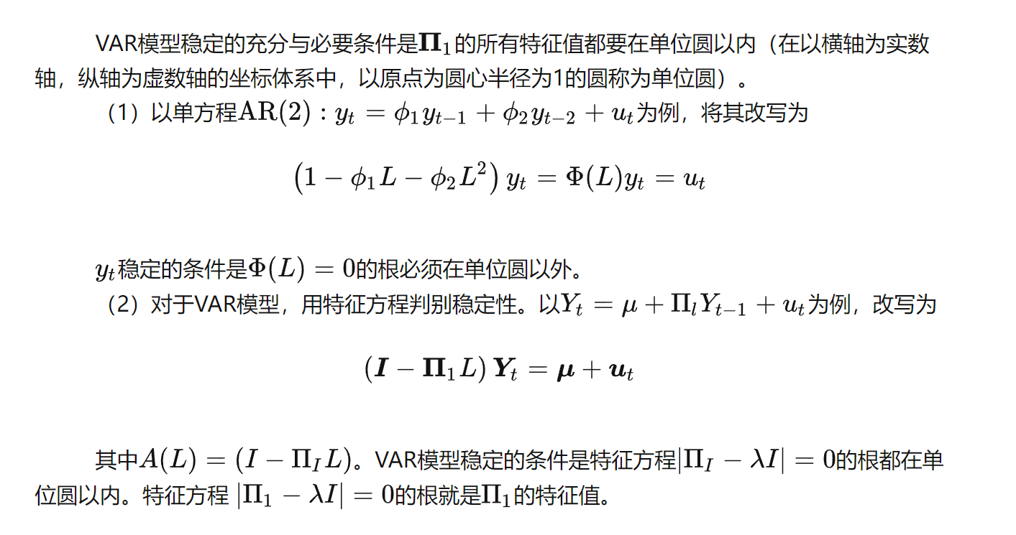
2.2 VAR – estimation - stationary

Slide 38
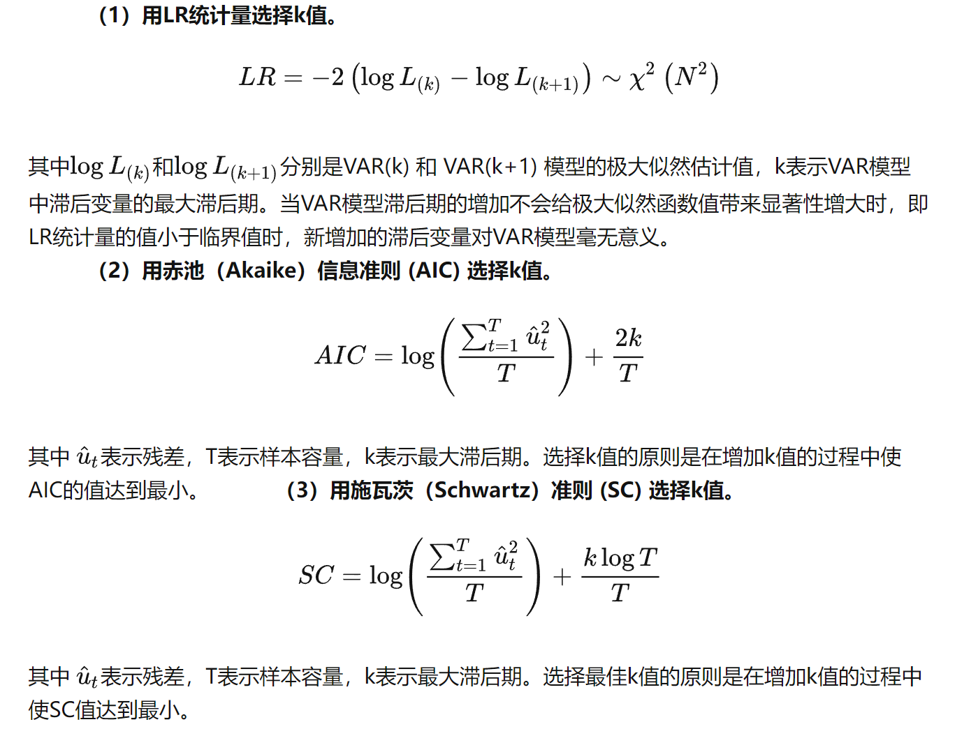
2.2 VAR – estimation – choose K

Slide 39
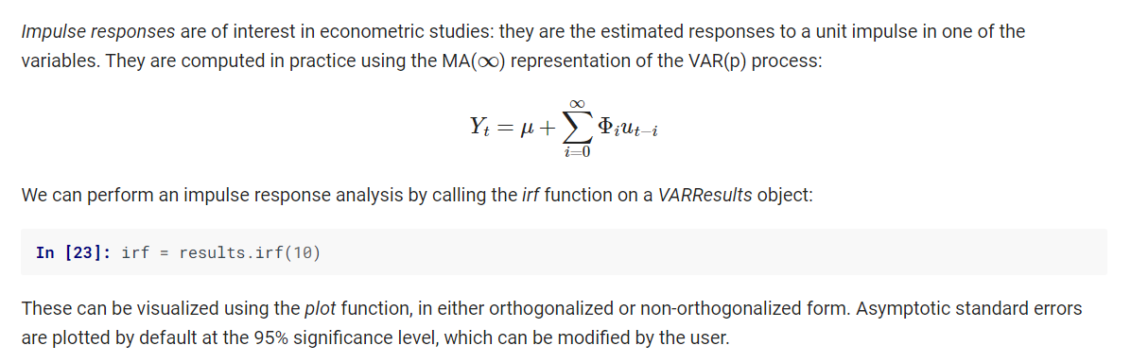
2.3 VAR – Impulse response

Slide 40
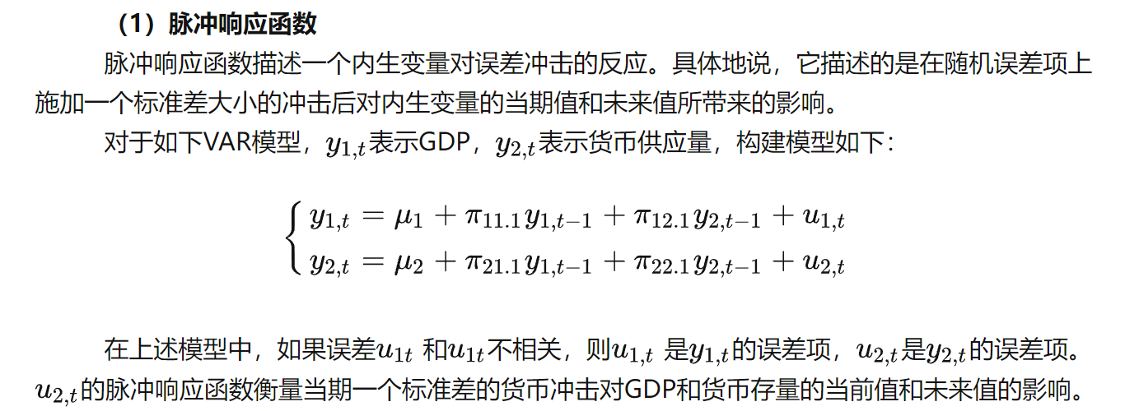
2.3 VAR – Impulse response

Slide 41
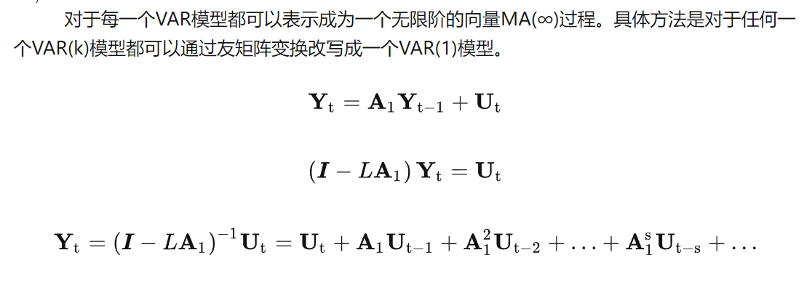
2.3 VAR – Impulse response

Slide 42
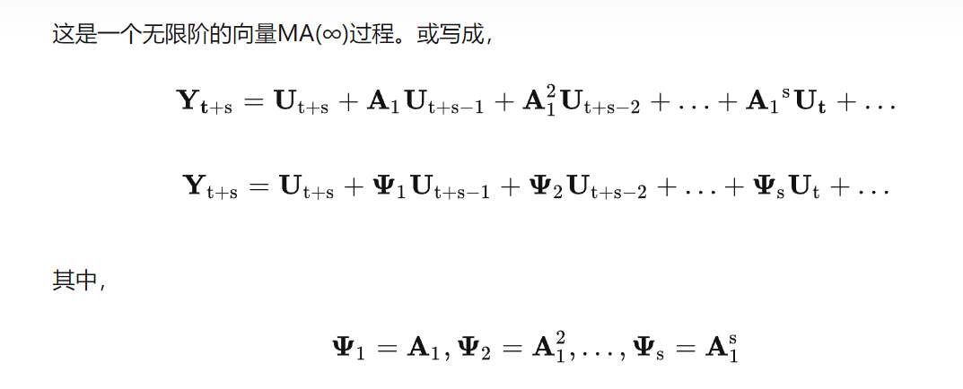
2.3 VAR – Impulse response

Slide 43
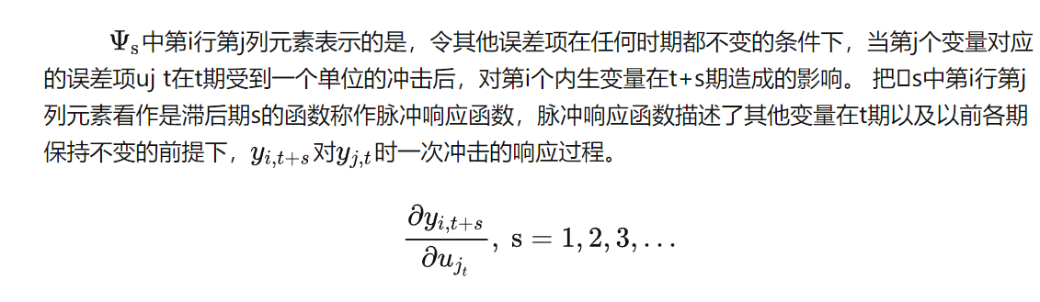
2.3 VAR – Impulse response

Slide 44
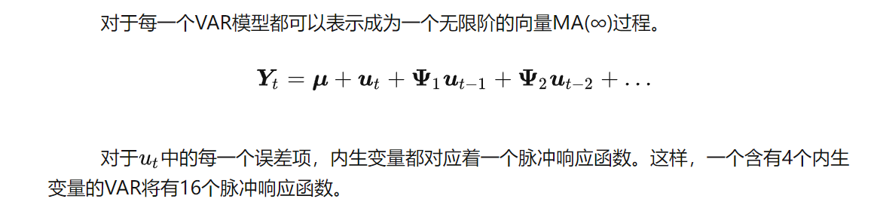
2.3 VAR – Impulse response

Slide 45
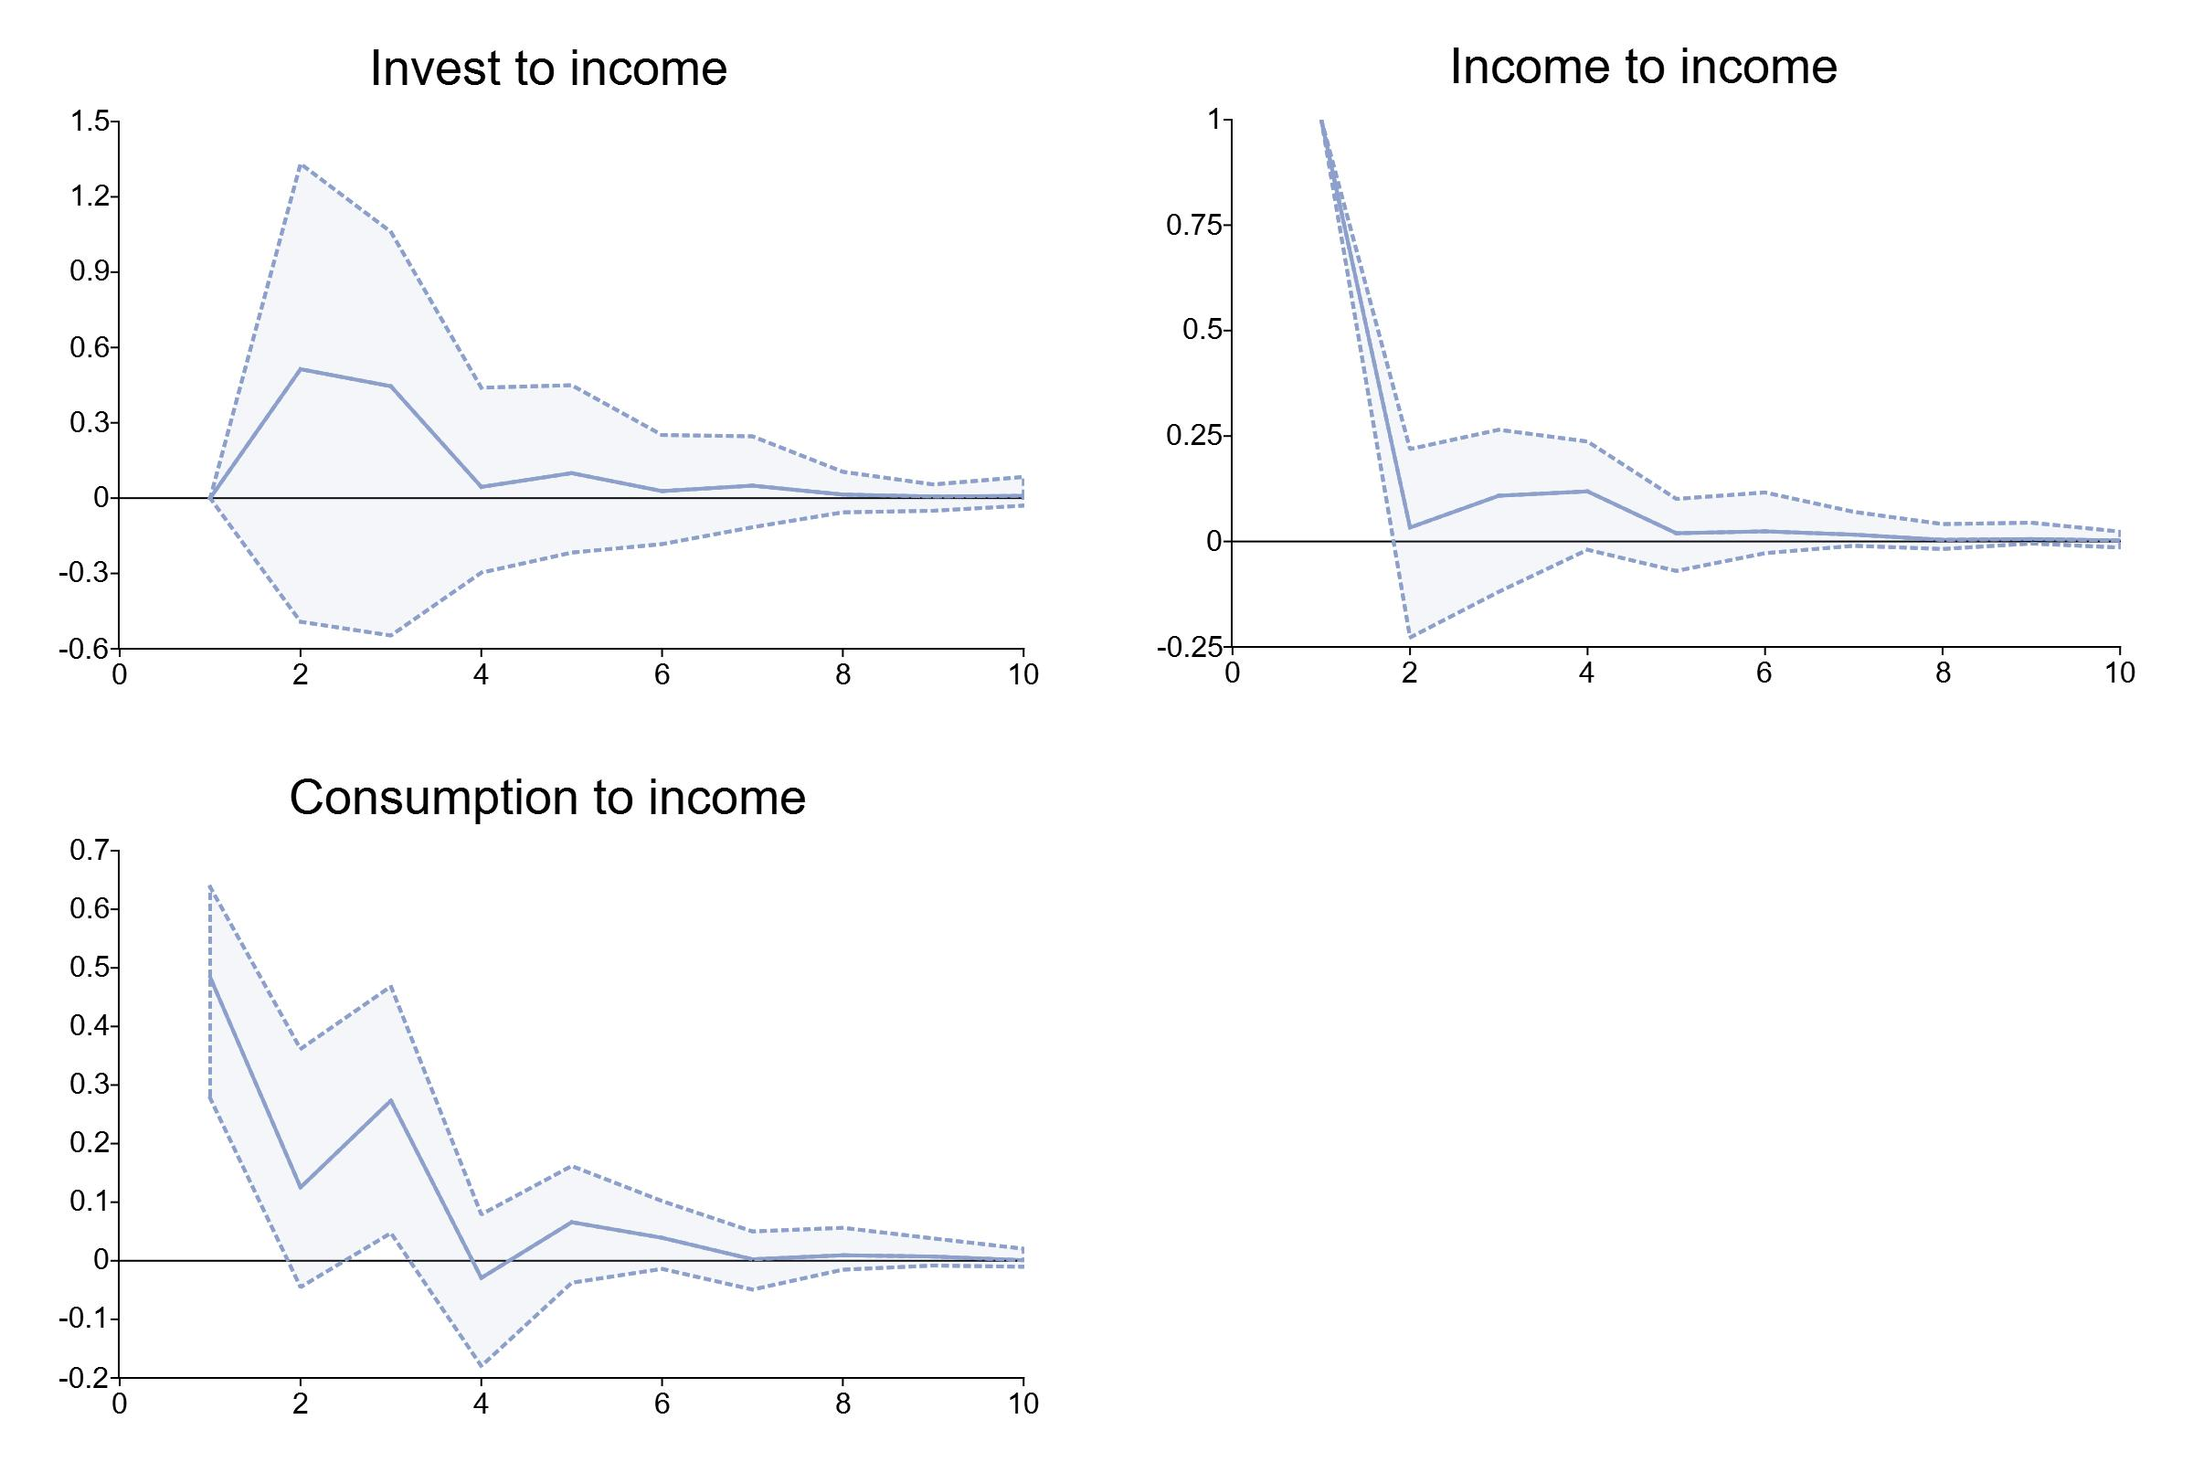
2.3 VAR – Impulse response

Slide 46

2.4 VAR – variance error decompositions

Slide 47
2.4 VAR – variance error decompositions
Forecast error variance decomposition (FEVD) is a part of structural analysis which "decomposes" the variance of the forecast error into the contributions from specific exogenous shocks.
Intuitively this is useful because it:
Demonstrates how important a shock is in explaining the variations of the variables in the model.
Shows how that importance changes over time. For example, some shocks may not be responsible for variations in the short-run but may cause longer-term fluctuations.

Slide 48

2.4 VAR – variance error decompositions

Slide 49
2.4 VAR – Granger Causality
In 1956 Norbert Wiener introduced a concept where while measuring two linear time series, if one can predict the first series by using the past information from both the series better than just plain vanilla prediction of the first series using its past information alone without the second series, then one may infer that the second series causes the first one.
The first practical work was done by Clive Granger after which the method is named Granger causality.Further advancements were also done by economist Gweke in 1982 and known as Gweke-Granger causality.
Therefore this concept extends the use cases of VAR models further where one can statistically test if one time series is the cause of the other.
If we have evidence that the first series granger causes the second one, we may infer that the first series is the cause and the second series is the effect.

Slide 50

2.4 VAR – Granger Causality

Slide 51

2.5 VAR – a case
1 数据读取

Slide 52


2.5 VAR – a case
1 数据准备 – 初步分析

Slide 53


2.5 VAR – a case
2 差分 – 平稳性

Slide 54

2.5 VAR – a case
3 VAR建模

Slide 55

2.5 VAR – a case

Slide 56

2.5 VAR – a case
3 VAR建模 – order selection

Slide 57


2.5 VAR – a case

Slide 58

2.5 VAR – a case
4 VAR建模 – prediction

Slide 59

2.5 VAR – a case

Slide 60

2.5 VAR – a case
5 VAR建模 – 脉冲响应分析
参数5，即分析一个单位标准差的冲击对未来5期的影响

Slide 61


Slide 62


2.5 VAR – a case
5 VAR建模 – 脉冲响应分析
也可以只plot其中一个

Slide 63


2.5 VAR – a case
5 VAR建模 – 脉冲响应分析
也可以plot累计影响

Slide 64


2.5 VAR – a case
6 VAR建模 – 格兰杰因果分析
第一个参数是果，第二个参数是因

Slide 65



2.5 VAR – a case
7 VAR建模 – 方差分解

Slide 66
2.5 VAR – a case

Slide 67

3 classwork

Slide 68

3 classwork
图1 绘制了1990 年至今的中国总出口同比增长率和芝加哥期权波动率指数的走势图，从中可以发现不确定性具有典型的逆周期特征:
当不确定性较低时，中国出口额增长;当不确定性增加时，贸易则出现剧烈的萎缩。

Slide 69

3 classwork

Slide 70

3 classwork

Slide 71

3 classwork

Slide 72

3 classwork

Slide 73


3 classwork

Slide 74

3 classwork

